Slide 1

Project Title - Seasonal Agriculture Performance Analysis
Student Name - Chitukula Pooja Reddy
College Name - Malla Reddy Engineering College for Women
AICTE STU ID : STU67d934607f1771742287968

Slide 2

PROBLEM STATEMENT
Agricultural activities are influenced by seasonal variations in environmental conditions, farming practices, resource availability and market conditions. As a result, agricultural performance may differ from one season to another.
However, raw agricultural data does not clearly explain how agricultural performance changes across seasons or what patterns can be observed in different seasonal conditions.
The problem is to analyze the given agricultural dataset and investigate seasonal differences in agricultural performance by identifying meaningful patterns, trends, relationships and variations within the available data

Slide 3
Project Description
The project is about analyzing agricultural data to understand how farming performance changes with different seasons, crops, and states. We used a dataset that contains details like rainfall, temperature, soil conditions, irrigation, fertilizer usage, crop yield, production, cost, revenue, profit, water usage, and disease or pest risk.
The main aim of our project is to find useful patterns in the data and understand which factors are related to better agricultural performance. We first cleaned the data and checked for missing values and duplicate records. Then we used statistical analysis and different graphs such as bar charts, histograms, boxplots, scatter plots, and a correlation heatmap to study the data.
Overall, this project helped us understand the agricultural dataset better and use data analysis to find meaningful results.

Slide 4

WHO ARE THE END USERS?
The main end users of this project are:
Farmers – to understand which seasons and crops show better performance.
Agricultural planners – to use the results for seasonal farming planning.
Agriculture officers – to compare agricultural performance across different regions.
Researchers and students – to study patterns and relationships in agricultural data.
Decision makers – to use the analysis as supporting information for agricultural decisions.

Slide 5

Technology Used
Python
Pandas
NumPy
Matplotlib
Seaborn
Google Colab

Slide 6
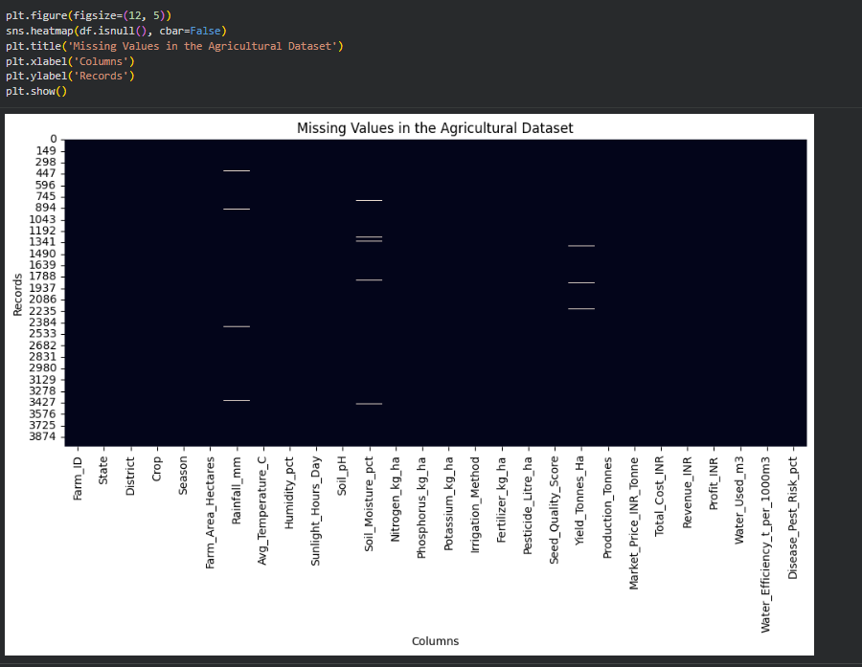
RESULTS
Missing Values in the Agricultural Dataset

Slide 7
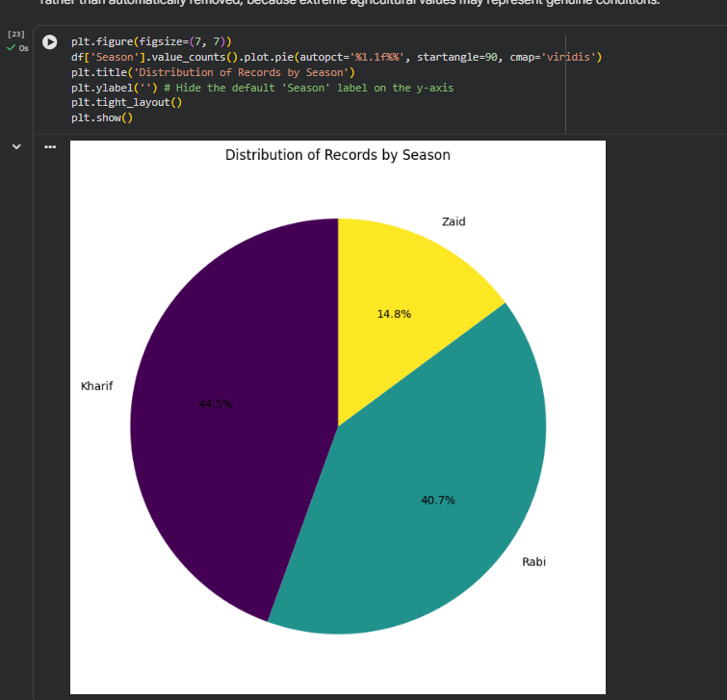
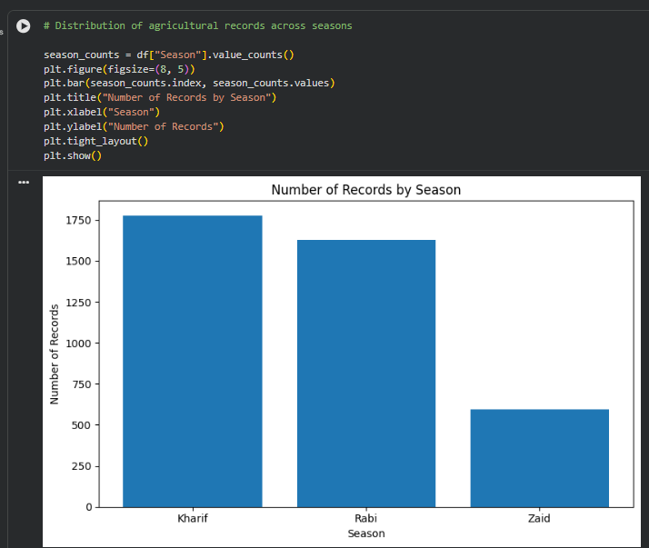
RESULTS
Distribution of Records by Season
Distribution of agricultural records across seasons

Slide 8
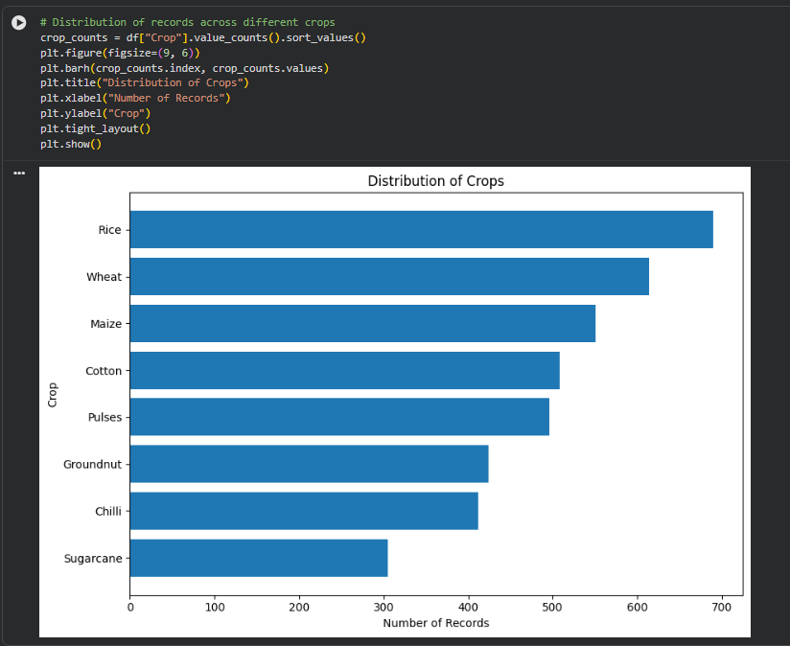
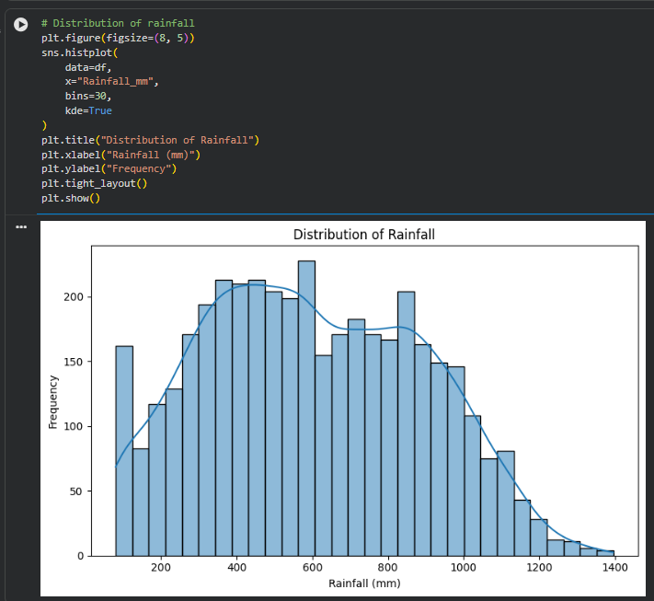
RESULTS
Distribution of records across different crops
Distribution of rainfall

Slide 9
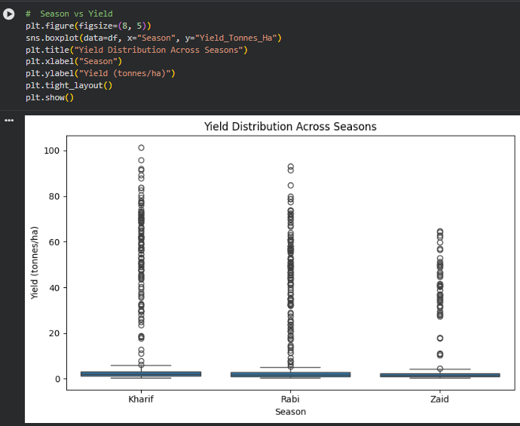
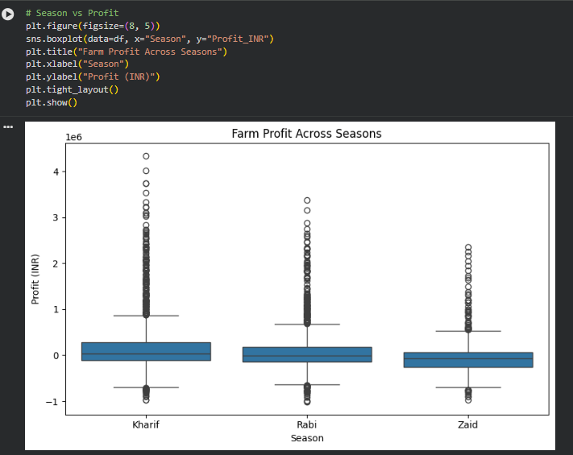
RESULTS
Season vs Yield
Season vs Profit

Slide 10
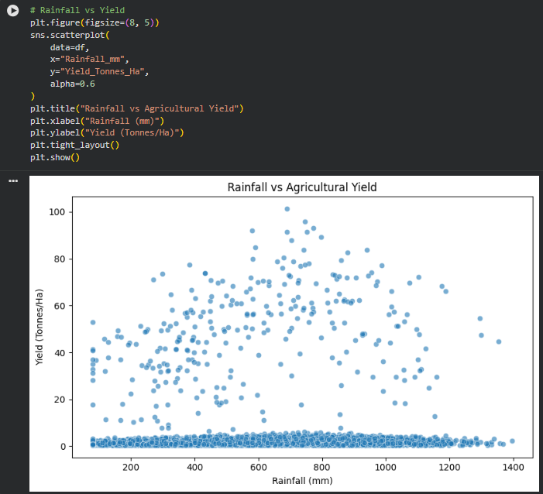
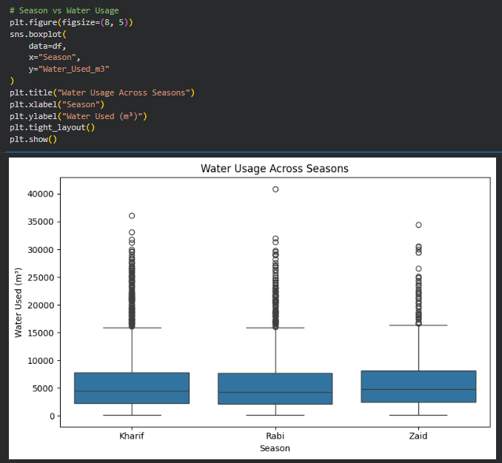
RESULTS
Rainfall vs Yield
Season vs Water Usage

Slide 11
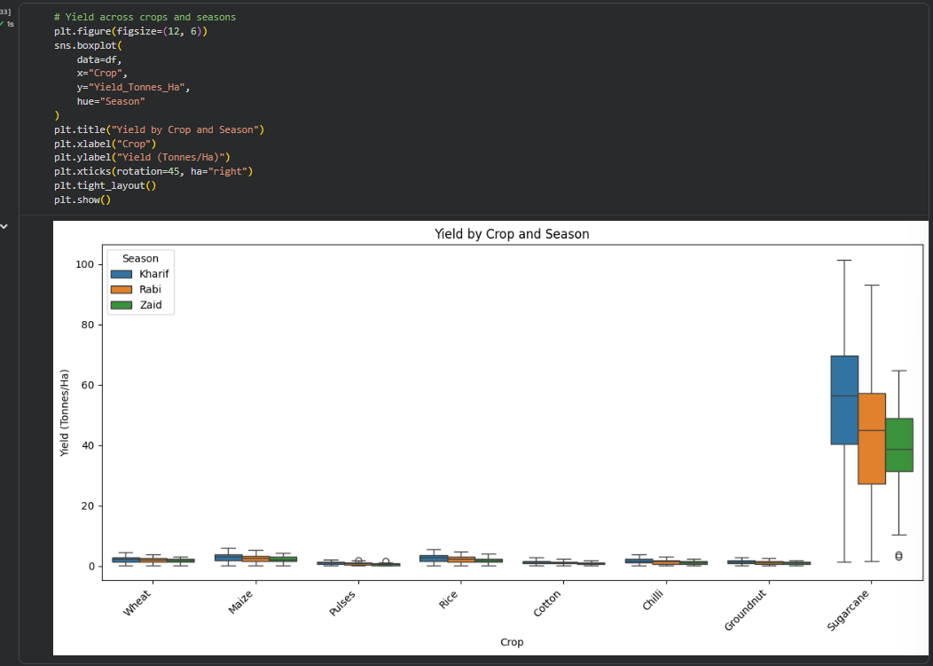
RESULTS
Yield across crops and seasons

Slide 12
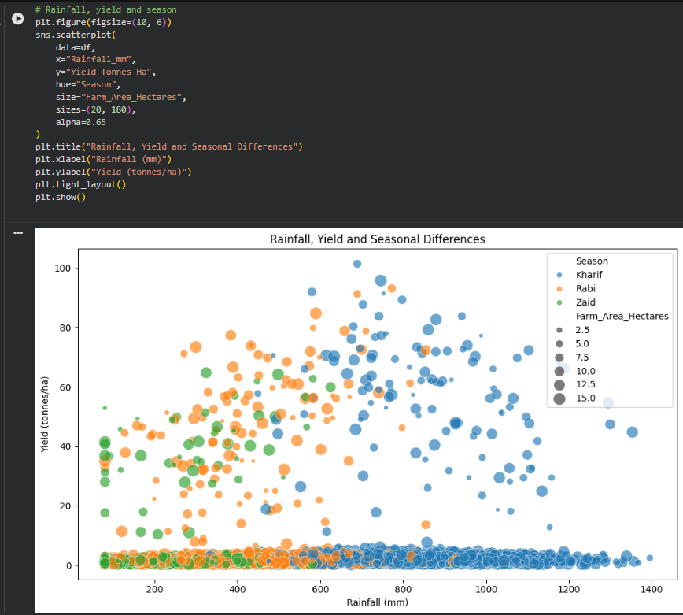
RESULTS
Rainfall, yield and season

Slide 13
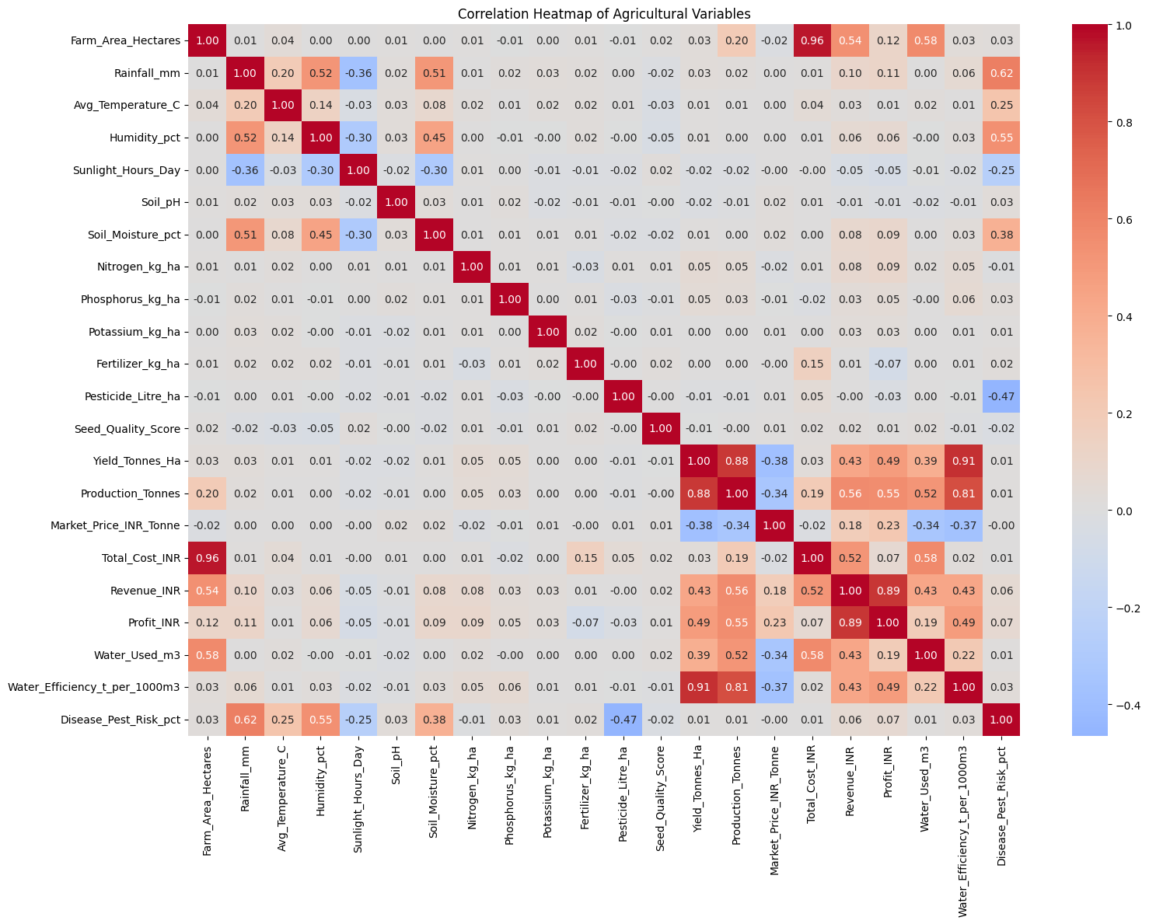
RESULTS
Correlation matrix for numerical variables

Slide 14
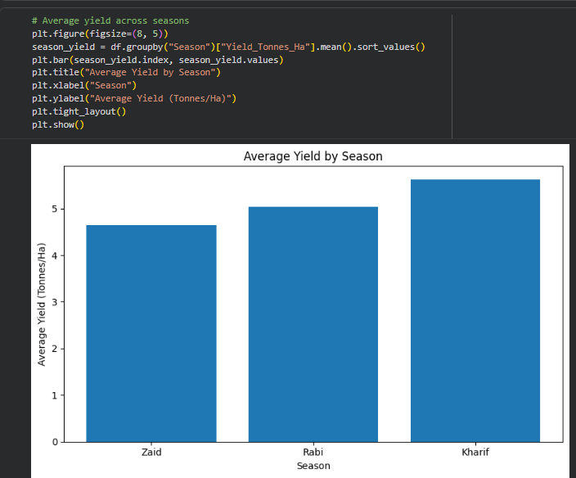
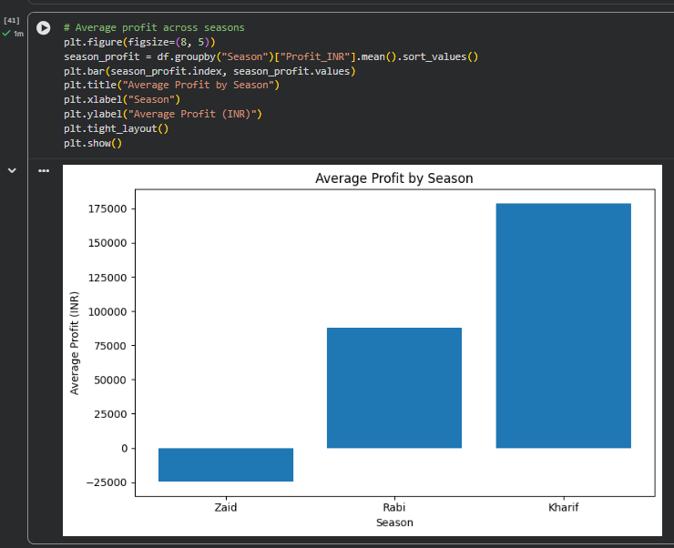
RESULTS
Average yield across seasons
Average profit across seasons

Slide 15
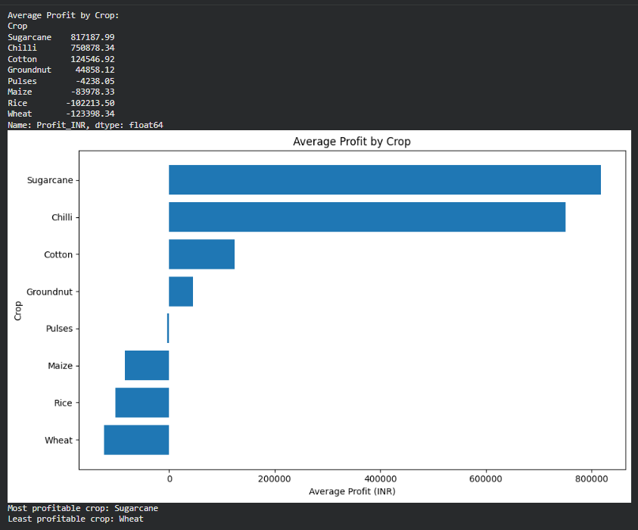
RESULTS
Analysis 1

Slide 16
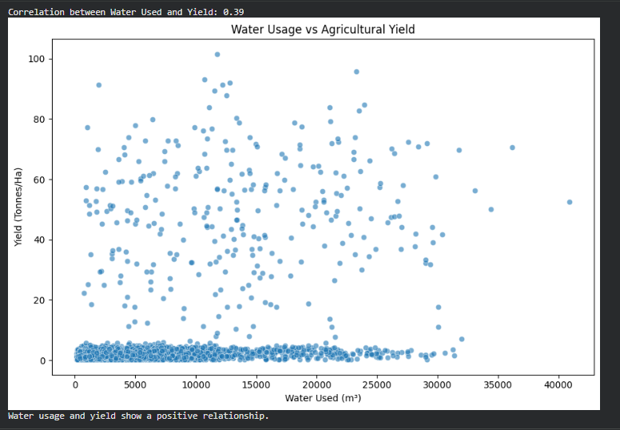
RESULTS
Analysis 2

Slide 17
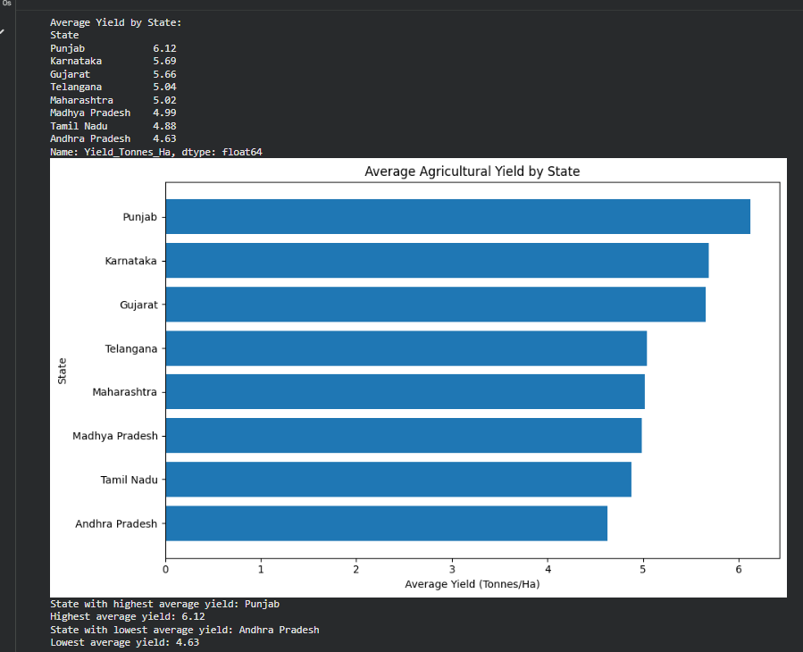
RESULTS
Analysis 3

Slide 18
Future scope
.
Using machine learning to predict crop yield and profit.
Adding real-time weather and market price data.
Adding more years of agricultural data for better seasonal comparison.
Including more information about soil, weather, and farming practices.
Developing a simple dashboard to display the analysis results.
Extending the analysis to more states, crops, and regions.
Using the results to provide more detailed recommendations for farmers

Slide 19
GitHub Link
https://github.com/chitukulapooja/Seasonal-Agriculture-Performance-Analysis

Slide 20

VOIS Course completion certificate - Course name- Data Visualization

Slide 21
Thank you
.
.

